Slide 1
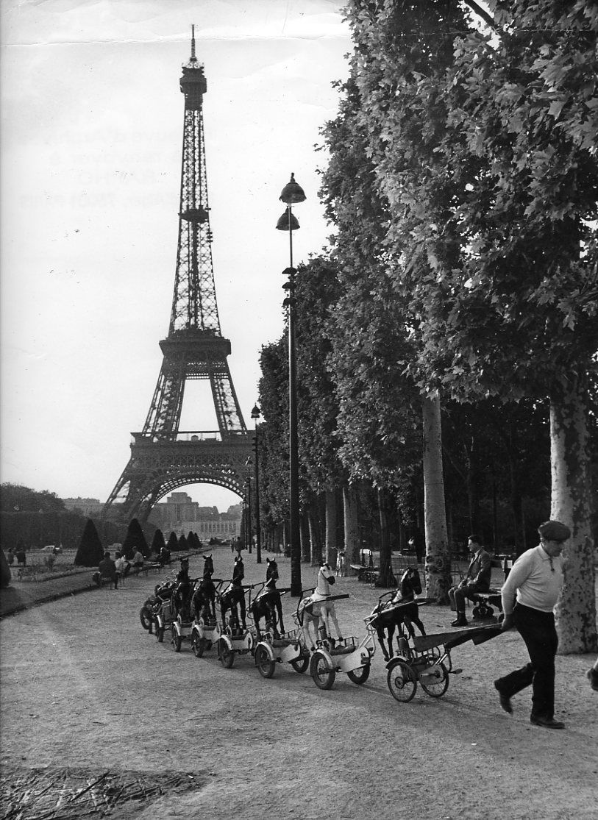
Lundi 12 août
Français I
Please take a book Espace in the back of the room P 546-551
Color and label the countries where French is spoken in the world.
No numbers, draw a line with a ruler or something else and write the name of the country in the margin clearly. Your grade will be based on completeness and neatness.
Please put books back on shelves at the end of class.
Remember the rules►
No phone, no earbuds, no chewing, back packs on the floor.
A demain! (See you tomorrow)

Slide 2
Lundi 12 août
Français II
Verb review – turn in for participation
Cahier (soft cover) Espace
Contrôle verbes être – prendre – ER – avoir et aller
mercredi
4 P 10
4 P 18
4 P 24
4 P 46
1 P 51
3 P 53

Slide 3
Lundi 12 août
Français PreAp/AP
Translation in groups of two
Please continue to the last three paragraphs if finished.

